Slide 1
IMSE 991 Multiple Criteria Decision Making
Lecture 9
PROMETHEE

Slide 2
Mid Term Exam Review
Exam Review

Slide 3
PROMETHEE
Outranking Methods
PROMETHEE I
PROMETHEE II

Slide 4
Outranking Methods
The underlying idea for the development of the outranking methods is to reveal a relation in between the dominance relation and the multi attribute value function
Outranking methods are used to enrich the dominance relation by some elements
Most outranking methods are non-compensatory

Slide 5
Outranking Methods
Example of Outranking Relationship
DM considers three cars based on two attributes
A1 = ($13,000, 18 MPG)
A2 = ($16,000, 21 MPG)
A3 = ($18,000, 25 MPG)
Alternatives non-dominate each other
No preference yet
But…a prior “likely preferred to” relationship may exist in the DM’s mind

Slide 6
Outranking Methods
Example of Outranking Relationship
The DM may prefer A1 to A2 because he or she does not want to pay an extra $3,000 for the 3 MPG improvement
Therefore, it defines that A1 outranks A2
Other preferences between alternatives also exist, but the preferences do not have to be transitive

Slide 7
Outranking Methods
Expression of Outranking Relationship
Expressed using the binary relationship R
Notation (A_{p} R A_{q}) or (A_{p} → A_{q})
Means A_{p} outranks A_{q}
Although two alternatives A_{p} and A_{q} do not dominate each other, it is realistic to accept the risk of regarding A_{p} as better A_{q}
Again, the outranking relationship R is not required to be transitive

Slide 8
Outranking Methods
Incomparability
When a DM must compare two alternatives, they will react in one of the three following ways:
Preference for one of them
Indifference between them
Refusal or inability to compare them

Slide 9
Outranking Methods
Incomparability
Two alternatives can perfectly remain incomparable without endangering the decision aid procedure
A conclusion of incomparability between some alternatives may also be quite helpful since it puts forward some aspects of the problem which would perhaps deserve a more thorough study

Slide 10
PROMETHEE
The acronym PROMETHEE stands for ‘Preference Ranking Organization METHod for Enriched Evaluation.’
Provides the decision maker with ranking actions (choices or alternatives) based on preference degrees

Slide 11
PROMETHEE
There are three main steps in the computational process
Computation of preference degrees for every ordered pair of actions on each criterion
Computation of unicriterion flows
Computation of global flows
Based on the global flows, a ranking of the actions will be obtained as well as a graphical representation of the decision problem

Slide 12
PROMETHEE
Case Study 6.1
Buying a new car
Price (minimized)
Consumption (minimized)
Comfort (maximized)
Power (maximized)

Slide 13
PROMETHEE
Case Study Data
Raw Data | Price | Consumption (km/l) | Comfort | Power (cc)
Min/Max | MIN | MIN | MAX | MAX
Economic | 15000 | 7.5 | Very Bad | 50
Sport | 29000 | 9 | Bad | 110
Luxury | 38000 | 8.5 | Very Good | 90
Touring A | 24000 | 8 | Average | 75
Touring B | 25500 | 7 | Average | 85
Conversion of qualitative value to numeric representation
Numeric Comfort
MAX
1
4
10
8
8

Slide 14
PROMETHEE
Unicriterion Preference Degrees
Preference degree – a score between 0 and 1 which expresses how an action is preferred over another action by the decision maker
Preference degree of 1 means a total or strong preference
Preference degree of 0 means there is no preference at all
Preference between 0 and 1 is somewhere in between the two

Slide 15
PROMETHEE
Unicriterion Preference Degrees
Pairwise preference degree of action A over action B, but the reverse is not true
Unicriterion preference degree is computed through rescaling or enriching the evaluations of the actions by means of preference information
It is important how the decision maker perceives the difference on every specific criterion

Slide 16
PROMETHEE
Preference functions
Two general types of preference functions discussed
Linear – gradual increase
Two parameters are necessary
q = indifference threshold
p = preference threshold
Gaussian – exponential function
One parameter is necessary
s = inflection point
Describe the preference relationships

Slide 17
PROMETHEE
Preference functions
1
0
1
0
q p
s
Linear preference function
Gaussian preference function

Slide 18
PROMETHEE
Three linear preference functions
1
0
1
0
1
0.5
0
q = p = 0
q = 0 p
q p
A strong preference for action as soon as there is a difference
No Indifference zone
Step function that can only take 3 values

Slide 19
PROMETHEE
Definition of evaluation terms
The set of actions to be ranked
A = {a₁, a₂, …, a_{n})
The set of criteria
F = {f₁, f₂, …, f_{m})
The evaluation of action a_{j} on criterion f_{i} = f_{i}(a_{j})
The difference between evaluations
d = f_{k}(a₁) - f_{k}(a_{j})

Slide 20
PROMETHEE
Criterion with Linear Preference
P_{k}(a_{i},a_{j}) =
Level Criterion
P_{k}(a_{i},a_{j}) =
P_{k}(a_{i},a_{j})
1
Criterion III
d
p_{k}
P_{k}(a_{i},a_{j})
1
0.5
q_{k}
p_{k}
d
Criterion IV

Slide 21
PROMETHEE
Criterion With Indifference Area.
P_{k}(a_{i},a_{j}) =
Gaussian Criterion
P_{k}(a_{i},a_{j}) =
P_{k}(a_{i},a_{j})
1
d
Criterion V
q_{k}
p_{k}
P_{k}(a_{i},a_{j})
1
d
Criterion VI
σ_{k}

Slide 22
Case Study 6.1
Preference Parameters of all the criteria
Criterion | Function | wi | qi | pi
price | linear | 0.25 | 2000 | 5000
consumption | linear | 0.25 | 0.5 | 1
comfort | linear | 0.25 | 1 | 2
power | linear | 0.25 | 10 | 20

Slide 23
PROMETHEE
Unicriterion preference degrees for price with a linear function when p = 5000 and q = 2000
Diagonals are 0 because an action cannot be preferred to itself
Economic is the cheapest and base point for comparison
Difference between Economic and Sport is 14000 so it is greater than the preference threshold p = 5000 and 0
Touring A and Touring B difference is 1500 so no preference between the cars
Touring B is cheaper than Sport so perform the following computation

Slide 24
PROMETHEE
Computation of the preference degree between the Touring B and Sport autos
Difference is 3500 and q = 2000 and p = 5000
1
0.5
0
2000 3500 5000
(3500 – 2000)/(5000-2000) = 0.5

Slide 25
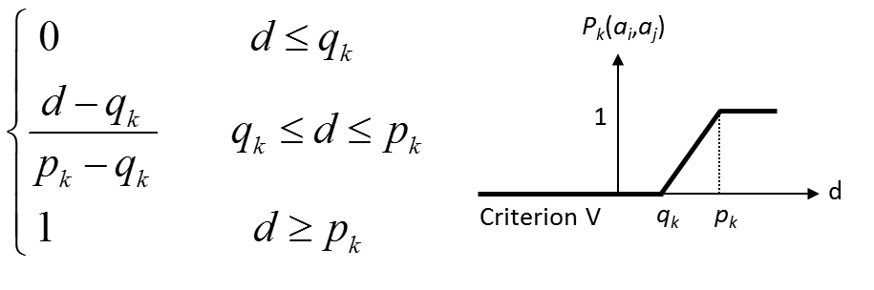
PROMETHEE
Price (minimized):
Unicriterion preference degrees with a linear function when q = 2000 and p = 5000 and
Difference | Economic | Sport | Luxury | Touring A | Touring B
Economic | 0 | -14000 | -23000 | -9000 | -10500
Sport | 14000 | 0 | -9000 | 5000 | 3500
Luxury | 23000 | 9000 | 0 | 14000 | 12500
Touring A | 9000 | -5000 | -14000 | 0 | -1500
Touring B | 10500 | -3500 | -12500 | 1500 | 0
Pref. Price | Economic | Sport | Luxury | Touring A | Touring B
Economic | 0 | 1 | 1 | 1 | 1
Sport | 0 | 0 | 1 | 0 | 0
Luxury | 0 | 0 | 0 | 0 | 0
Touring A | 0 | 1 | 1 | 0 | 0
Touring B | 0 | 0.5 | 1 | 0 | 0
Raw Data | Price | Consumption (km/l) | Comfort | Power (cc)
Min/Max | MIN | MIN | MAX | MAX
Economic | 15000 | 7.5 | Very Bad | 50
Sport | 29000 | 9 | Bad | 110
Luxury | 38000 | 8.5 | Very Good | 90
Touring A | 24000 | 8 | Average | 75
Touring B | 25500 | 7 | Average | 85

Slide 26
PROMETHEE
Graphical Representation of the Preferences
If the preference of car A over car B is greater than 0, then there is an arrow from A to B
Strength is represented by the arrow
Touring B
Economic
Sport
Luxury
`
Touring A

Slide 27
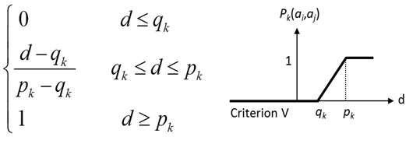
PROMETHEE
Consumption (minimized):
Unicriterion preference degrees with a linear function when q = 0.5 and p = 1.0
Difference | Economic | Sport | Luxury | Touring A | Touring B
Economic | 0 | -1.5 | -1 | -0.5 | 0.5
Sport | 1.5 | 0 | 0.5 | 1 | 2
Luxury | 1 | -0.5 | 0 | 0.5 | 1.5
Touring A | 0.5 | -1 | -0.5 | 0 | 1
Touring B | -0.5 | -2 | -1.5 | -1 | 0
Pref. Price | Economic | Sport | Luxury | Touring A | Touring B
Economic | 0 | 1 | 1 | 0 | 0
Sport | 0 | 0 | 0 | 0 | 0
Luxury | 0 | 0 | 0 | 0 | 0
Touring A | 0 | 1 | 0 | 0 | 0
Touring B | 0 | 1 | 1 | 1 | 0

Slide 28
PROMETHEE
Comfort (maximized):
Unicriterion preference degrees with a linear function when q = 1 and p = 2
Difference | Economic | Sport | Luxury | Touring A | Touring B
Economic | 0 | -3 | -9 | -7 | -7
Sport | 3 | 0 | -6 | -4 | -4
Luxury | 9 | 6 | 0 | 2 | 2
Touring A | 7 | 4 | -2 | 0 | 0
Touring B | 7 | 4 | -2 | 0 | 0
Pref. Price | Economic | Sport | Luxury | Touring A | Touring B
Economic | 0 | 0 | 0 | 0 | 0
Sport | 1 | 0 | 0 | 0 | 0
Luxury | 1 | 1 | 0 | 1 | 1
Touring A | 1 | 1 | 0 | 0 | 0
Touring B | 1 | 1 | 0 | 0 | 0

Slide 29
PROMETHEE
Power (maximized):
Unicriterion preference degrees with a linear function when q = 10 and p = 20
Difference | Economic | Sport | Luxury | Touring A | Touring B
Economic | 0 | -60 | -40 | -25 | -35
Sport | 60 | 0 | 20 | 35 | 25
Luxury | 40 | -20 | 0 | 15 | 5
Touring A | 25 | -35 | -15 | 0 | -10
Touring B | 35 | -25 | -5 | 10 | 0
Pref. Price | Economic | Sport | Luxury | Touring A | Touring B
Economic | 0 | 0 | 0 | 0 | 0
Sport | 1 | 0 | 1 | 1 | 1
Luxury | 1 | 0 | 0 | 0.5 | 0
Touring A | 1 | 0 | 0 | 0 | 0
Touring B | 1 | 0 | 0 | 0 | 0

Slide 30
PROMETHEE
Unicriterion positive, negative and net flows
Difficult to draw conclusions from the preference degree tables
Summarized into
Leaving or positive flows
Entering or negative flows
Net flows
Measure how an action is preferred over all other actions

Slide 31
Necessary Calculations
Multiattribute Preference Index
π(a_{i},a_{j}) =
Weight each of the matrices with the criteria weights
Criterion | wi
Price | 0.25
Consumption | 0.25
Comfort | 0.25
Power | 0.25

Slide 32
Necessary Calculations
Weight each of the matrices
Weighted Pairwise Comparison Matrix for Price
Pref. Price | Economic | Sport | Luxury | Touring A | Touring B
Economic | 0 | 0.25 | 0.25 | 0.25 | 0.25
Sport | 0 | 0 | 0.25 | 0 | 0
Luxury | 0 | 0 | 0 | 0 | 0
Touring A | 0 | 0.25 | 0.25 | 0 | 0
Touring B | 0 | 0.125 | 0.25 | 0 | 0
Weighted Pairwise Comparison Matrix for Consumption
Pref. Price | Economic | Sport | Luxury | Touring A | Touring B
Economic | 0 | 0.25 | 0.25 | 0 | 0
Sport | 0 | 0 | 0 | 0 | 0
Luxury | 0 | 0 | 0 | 0 | 0
Touring A | 0 | 0.25 | 0 | 0 | 0
Touring B | 0 | 0.25 | 0.25 | 0.25 | 0

Slide 33
Necessary Calculations
Weight each of the matrices
Weighted Pairwise Comparison Matrix for Comfort
Pref. Price | Economic | Sport | Luxury | Touring A | Touring B
Economic | 0 | 0 | 0 | 0 | 0
Sport | 0.25 | 0 | 0 | 0 | 0
Luxury | 0.25 | 0.25 | 0 | 0.25 | 0.25
Touring A | 0.25 | 0.25 | 0 | 0 | 0
Touring B | 0.25 | 0.25 | 0 | 0 | 0
Weighted Pairwise Comparison Matrix for Power
Pref. Price | Economic | Sport | Luxury | Touring A | Touring B
Economic | 0 | 0 | 0 | 0 | 0
Sport | 0.25 | 0 | 0.25 | 0.25 | 0.25
Luxury | 0.25 | 0 | 0 | 0.125 | 0
Touring A | 0.25 | 0 | 0 | 0 | 0
Touring B | 0.25 | 0 | 0 | 0 | 0

Slide 34
Necessary Calculations
Weighted Pairwise Matrix – Across all criteria
Sum of the weighted pairwise comparison matrix across all criterion
Computation of the weighted pairwise preference matrix
Preference | Economic | Sport | Luxury | Touring A | Touring B
Economic | 0 | 0.5 | 0.5 | 0.25 | 0.25
Sport | 0.5 | 0 | 0.5 | 0.25 | 0.25
Luxury | 0.5 | 0.25 | 0 | 0.375 | 0.25
Touring A | 0.5 | 0.75 | 0.25 | 0 | 0
Touring B | 0.5 | 0.625 | 0.5 | 0.25 | 0

Slide 35
Necessary Calculations
Leaving Flow
Entering Flow
Net Flow

Slide 36
PROMETHEE
Positive flows
Indicates how an action is preferred over all other actions
Sum across each action and divide by (n-1)
Preference | Economic | Sport | Luxury | Touring A | Touring B | Φ⁺(a)
Economic | 0 | 0.5 | 0.5 | 0.25 | 0.25 | 0.375
Sport | 0.5 | 0 | 0.5 | 0.25 | 0.25 | 0.375
Luxury | 0.5 | 0.25 | 0 | 0.375 | 0.25 | 0.34375
Touring A | 0.5 | 0.75 | 0.25 | 0 | 0 | 0.375
Touring B | 0.5 | 0.625 | 0.5 | 0.25 | 0 | 0.46875

Slide 37
PROMETHEE
Negative net flow
Sum between each action and divide by (n-1)
Preference | Economic | Sport | Luxury | Touring A | Touring B
Economic | 0 | 0.5 | 0.5 | 0.25 | 0.25
Sport | 0.5 | 0 | 0.5 | 0.25 | 0.25
Luxury | 0.5 | 0.25 | 0 | 0.375 | 0.25
Touring A | 0.5 | 0.75 | 0.25 | 0 | 0
Touring B | 0.5 | 0.625 | 0.5 | 0.25 | 0
Φ⁻(a) | 0.5 | 0.53125 | 0.4375 | 0.28125 | 0.1875

Slide 38
PROMETHEE
Positive and Negative Net Flows
Net Flows
 | Positive Net Flows | Negative Net Flows
Economic | 0.375 | 0.5
Sport | 0.375 | 0.53125
Luxury | 0.34375 | 0.4375
Touring A | 0.375 | 0.28125
Touring B | 0.46875 | 0.1875

Slide 39
PROMETHEE
Positive Outranking Flow
The positive outranking flow expresses how an alterative a is outranking all of the others
It is its power, its outranking character
The higher Φ⁺(a), the better the alternative

Slide 40
PROMETHEE
Negative Outranking Flow
The negative outranking flow expresses how an alterative a is outranked by all the others.
It is its weakness, its outranked character.
The lower Φ⁻(a), the better the alternative

Slide 41
PROMETHEE I
PROMETHEE I ranking is based on the positive and negative net flows
Two complete preorders are built:
Ranking the alternatives following the decreasing order of leaving flows
Ranking the alternatives following the increasing order of entering flows
The intersection of the preorders yields the partial preorder

Slide 42
PROMETHEE I
Partial Ranking

Slide 43
PROMETHEE II
A unique complete preorder is built:
Ranking the alternatives following the decreasing order of net flows

Slide 44
PROMETHEE II
Overall net flows
Subtract the negative flows from the positive flows
Net score lies between -1 and 1
Net Flows
 | Positive Net Flows | Negative Net Flows | Total Net Flows
Economic | 0.375 | 0.5 | -0.125
Sport | 0.375 | 0.53125 | -0.15625
Luxury | 0.34375 | 0.4375 | -0.09375
Touring A | 0.375 | 0.28125 | 0.09375
Touring B | 0.46875 | 0.1875 | 0.28125

Slide 45
PROMETHEE II
Total Net Flows

Slide 46
Properties of the Net Flow
Unicriterion net flows:

Slide 47
Unicriterion Net Flows
Unicriterion Net Flows
Unicriterion Net Flows
 | Price Net Flows | Consumption Net Flows | Comfort Net Flows | Power Net Flows
Economic | 1 | 0.5 | -1 | -1
Sport | -0.375 | -0.75 | -0.5 | 1
Luxury | -1 | -0.5 | 1 | 0.125
Touring A | 0.25 | 0 | 0.25 | -0.125
Touring B | 0.125 | 0.75 | 0.25 | 0

Slide 48
Weighted Unicriterion Net Flows
Weighted Unicriterion Net Flows
Weighted Unicriterion Net Flows
 | Price Net Flows | Consumption Net Flows | Comfort Net Flows | Power Net Flows
Economic | 0.25 | 0.125 | -0.25 | -0.25
Sport | -0.09375 | -0.1875 | -0.125 | 0.25
Luxury | -0.25 | -0.125 | 0.25 | 0.03125
Touring A | 0.0625 | 0 | 0.0625 | -0.03125
Touring B | 0.03125 | 0.1875 | 0.0625 | 0

Slide 49
Weighted Unicriterion Net Flows
Weighted Unicriterion Net Flow Dieagram

Slide 50
PROMETHEE II
Complete Ranking
 | Rank | Total NF |  |  | Rank | Total NF |  |  | Rank | Total NF |  |  | Rank | Total NF |  |  | Rank | Total NF
Touring B | 1 | 0.281 |  | Touring A | 2 | 0.094 |  | Luxury | 3 | -0.094 |  | Economic | 4 | -0.125 |  | Sport | 5 | -0.156

Slide 51
GAIA
Visual representation of a decision problem
Uses the Unicriterion Net flows computed by the PROMETHEE method
M (n x k) matrix – Single Criterion Net Flows

Slide 52
GAIA
N alternatives can be represented as a cloud of n points in a k-dimensional space
The cloud is centered at the origin
With the number of criteria larger than 2, it is impossible to obtain a clear view of the relative positions of the points with regard to the criteria
We project the information in the k-dimensional space on a plane.
We project both the points and the unit vectors of the coordinate-axes representing the criteria

Slide 53
GAIA
Projection on the GAIA plane

Slide 54
GAIA
The GAIA plane is the plane for which as much information as possible is preserved after projection
The GAIA plane is as meta model (model of a model)

Slide 55
GAIA
Alternatives and criteria in the GAIA plane

Slide 56
GAIA
Properties associated with GAIA
P1: The longer a criterion axis on the GAIA plane, the more discriminating this criterion
P2: Criteria expressing similar preferences are represented by axes oriented in approximately the same direction
P3: Criteria expressing conflicting preferences are oriented in opposite directions

Slide 57
GAIA
Properties associated with GAIA
P4: Criteria that are not related to each other in terms of preferences are represented by orthogonal axes.
P5: Similar alternatives are represented by points located close to each other
P6: Alternatives being good on a particular criterion are represented by points located in the direction of the corresponding criterion axis.

Slide 58
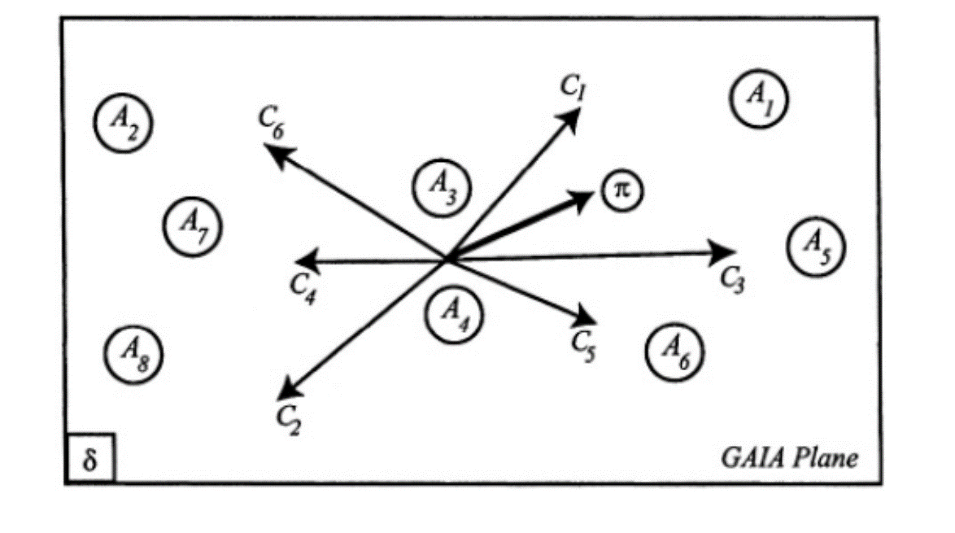
GAIA
Interpretation
Criteria g1 and g3 are expressing similar preferences and that the alternatives a1 and a5 are rather good on these criteria.
Criteria g6 and g4 are also expressing similar preferences and that the alternatives a2, a7, a8 are rather good on them
Criteria g2 and g5 are rather independent

Slide 59
GAIA
Interpretation
Criteria g1 and g3 are strongly conflicting with criteria g4 and g2
Alternatives a1, a5 and a6 are rather good on the criteria g1, g3 and g5
Alternatives a2, a7 and a8 are rather good on the criteria g6, g4 and g2
Alternatives a3 and a4 are never good, never bad on all the criteria

Slide 60
IMSE 991 Multiple Criteria Decision Making
Lecture 9
PROMETHEE

